Slide 1
The Striatum Organizes 3D Behavior via Moment-to-Moment Action Selection
Markowitz et al., 2018, Cell
(Sandeep R. Datta lab)
Sur lab Journal Club, Jul 5, 2018

Slide 2
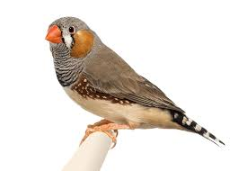
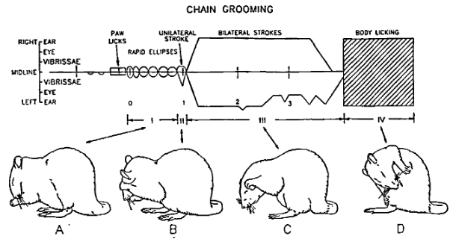
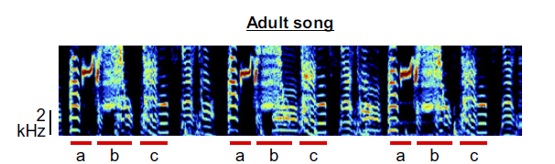
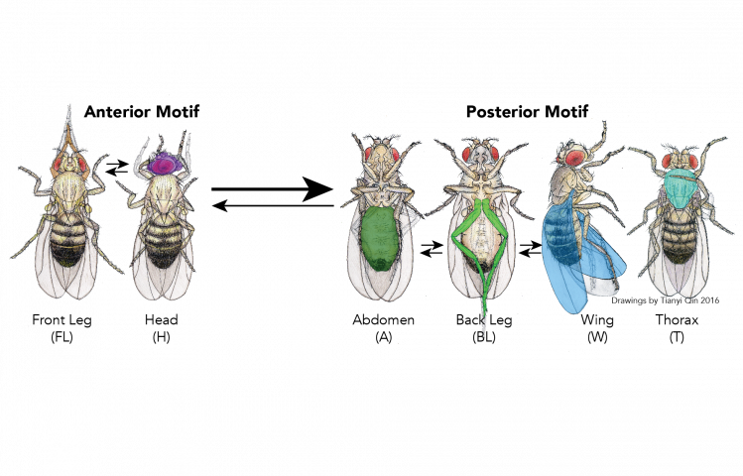
Animal behavior is often composed of sequences of discrete components
Aldridge et al., 1993
Goldberg & Fee, 2011
How are these sequences encoded and coordinated without external input?
Seeds et al., 2014

Slide 3
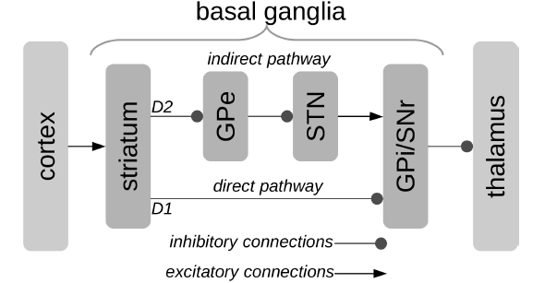
The basal ganglia and action selection
Traditional model of action selection:
direct-indirect pathway
Direct pathway (D2 cells)
selects actions
Indirect pathway (D1 cells) inhibits unwanted behaviors
Stewart et al., 2010

Slide 4
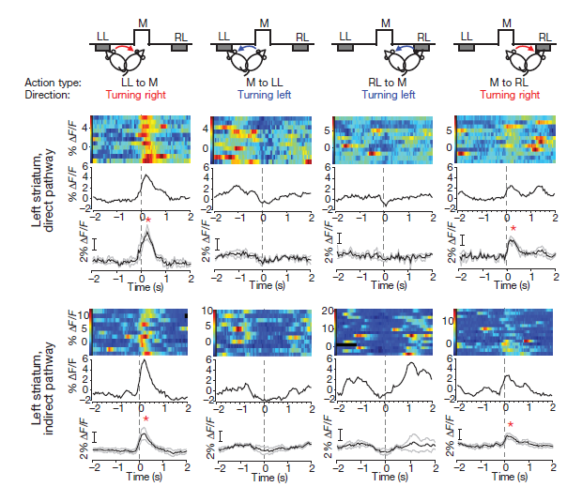
The basal ganglia and action selection
However, Cui et al., 2014: both pathways are activated during an action
Cui et al., 2014

Slide 5
The basal ganglia encodes kinematics of behavior
Within dorsal striatum, neural correlates have been found for
Body velocity
Speed of head movements
Turn angle
Reaching kinematics
Striatal activity can represent start and stop of an action sequence (Jin and Costa, 2010)

Slide 6
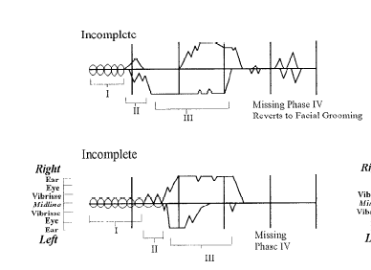
Lesion of dorsolateral striatum (DLS) alters grooming sequence in rodents
Aldridge et al., 1993

Slide 7
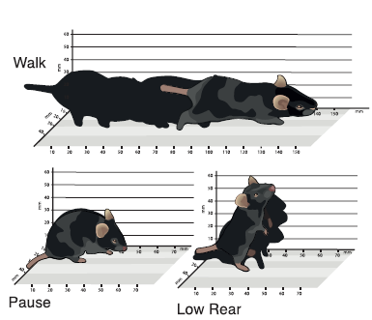
Main question
How might activities in the direct and indirect pathways contribute to behavior and behavioral sequencing in mice?
Natural behavior “syllables” (Wiltschko et al., 2015)

Slide 8
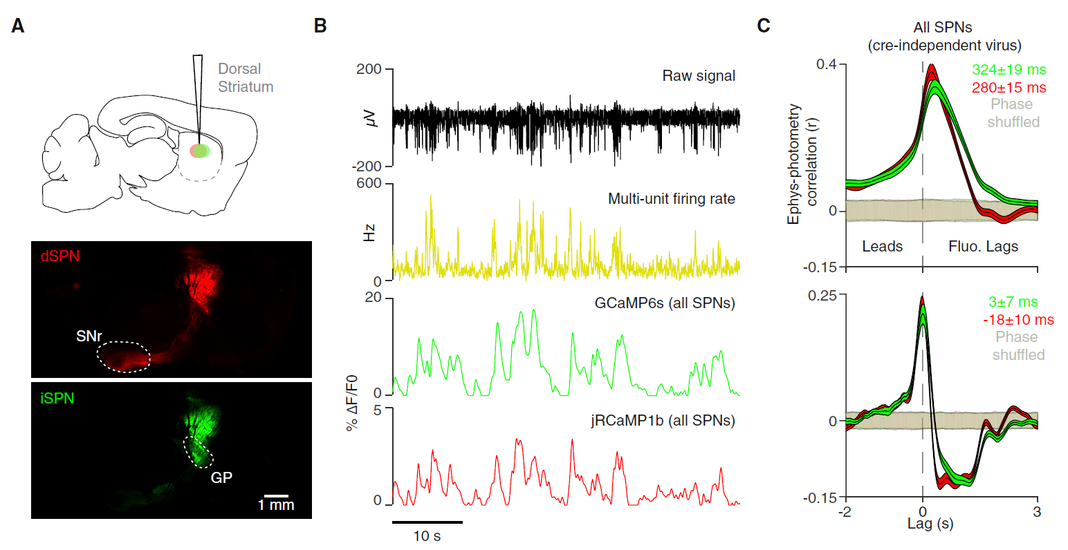
Methods
Monitor direct-indirect pathway overall activity: multicolor photometry system
- Drd1a-Cre mice
Direct: Cre-On AAV expressing jRCaMP1b
Indirect: Cre-Off AAV expressing GCaMP6s.

Slide 9
Methods
Monitor direct-indirect pathway overall activity: multicolor photometry system

Slide 10
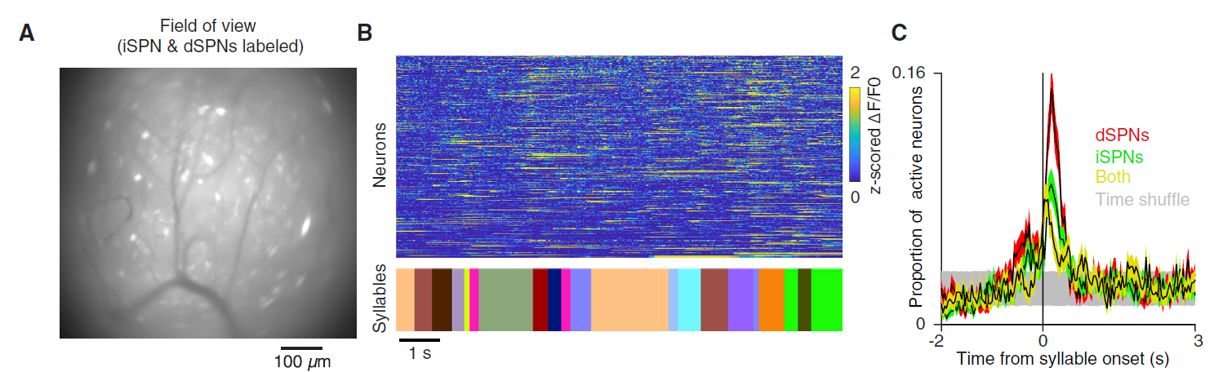
Methods
Monitor direct-indirect single neuron activity: GRIN lens
Cell labeling:
Direct: Drd1a-Cre, Cre-dependent AAVs
Indirect: A2a-Cre, Cre-dependent AAVs
Both: Cre-independent AAV

Slide 11
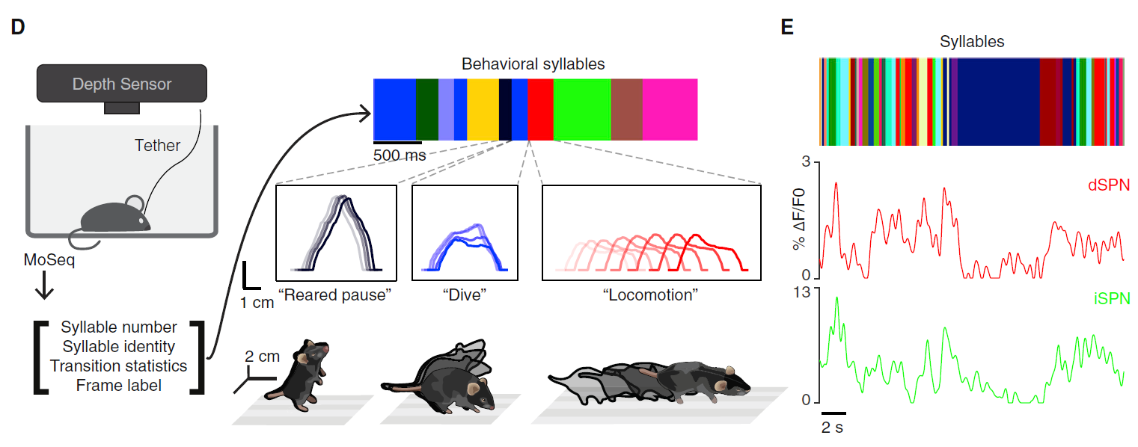
Methods
Monitor and segment behavior syllables: MoSeq algorithm

Slide 12
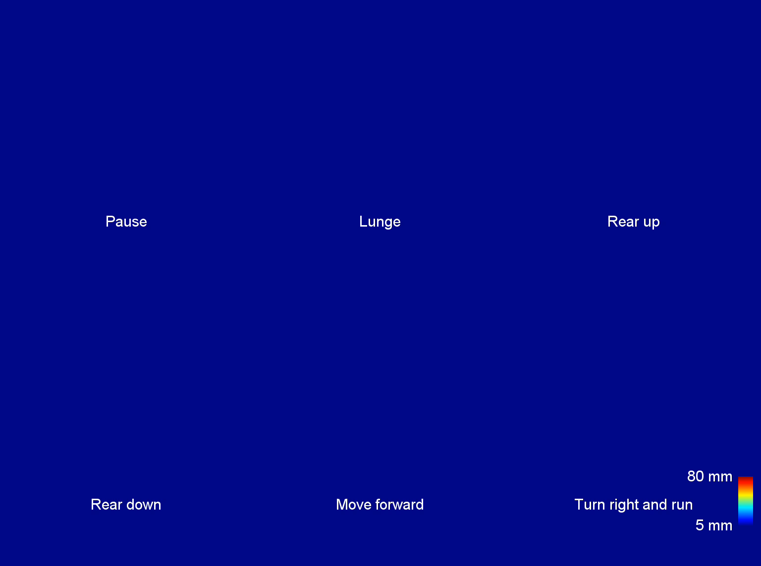

Slide 13
Main claims
Identity of behavior syllables is jointly encoded in the pattern of activity in direct and indirect pathways.
Activity in both pathways depends on the context in which the syllable is expressed.
Lesion of the dorsolateral striatum (DLS) alters the expression and sequencing, but not the content, of behavioral syllables.

Slide 14
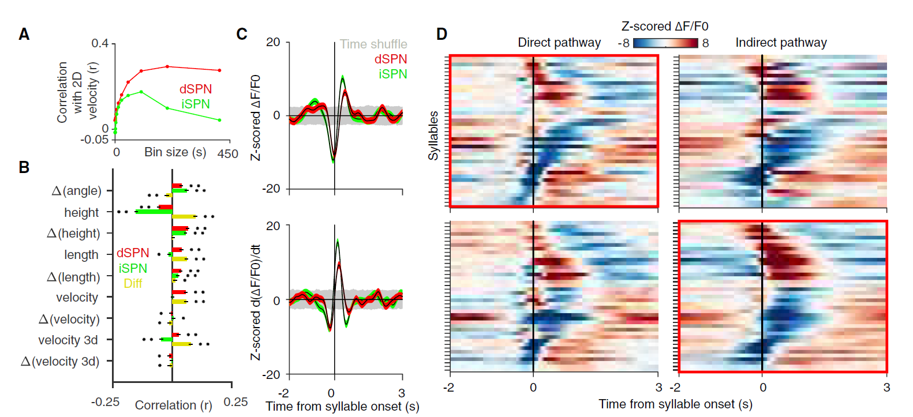
Correlation between movement parameters and pathway activity

Slide 15
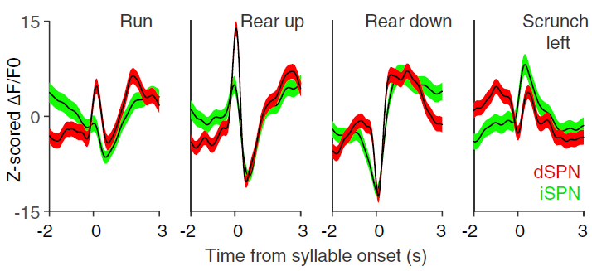
Syllables correspond to distinct direct-indirect pathway activity

Slide 16
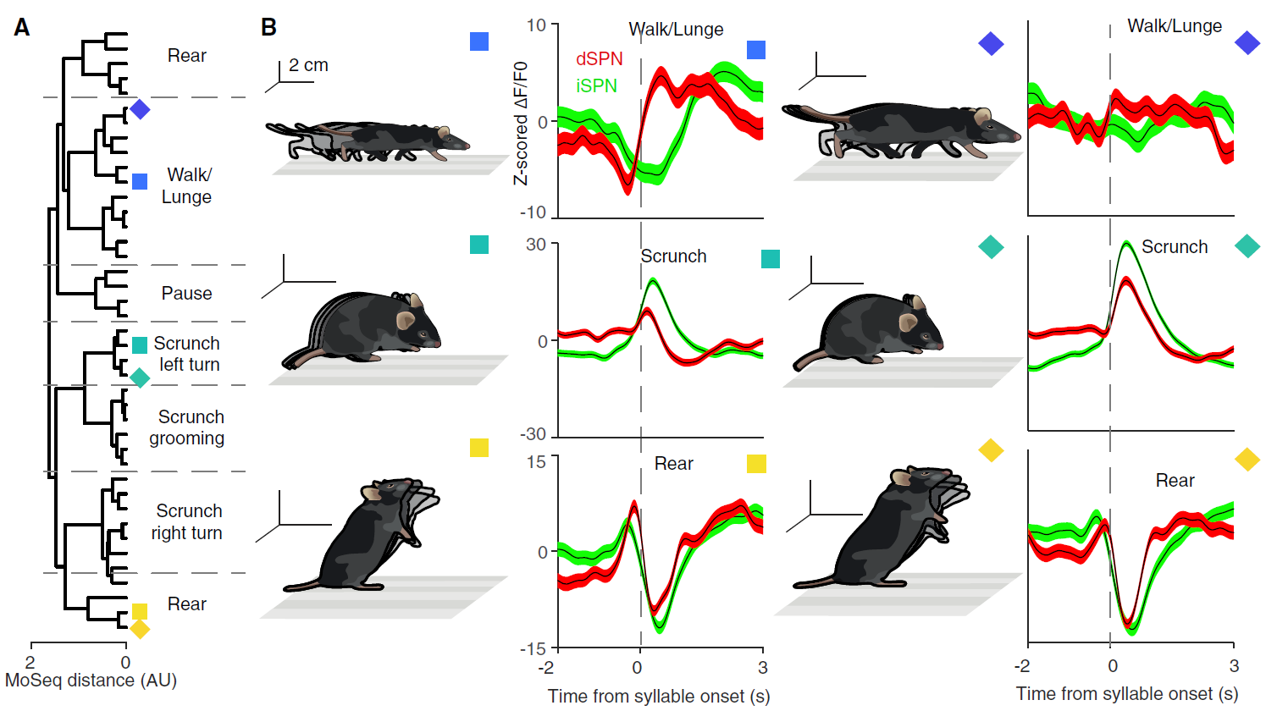
Morphologically related behavioral syllables were associated with similar waveforms

Slide 17
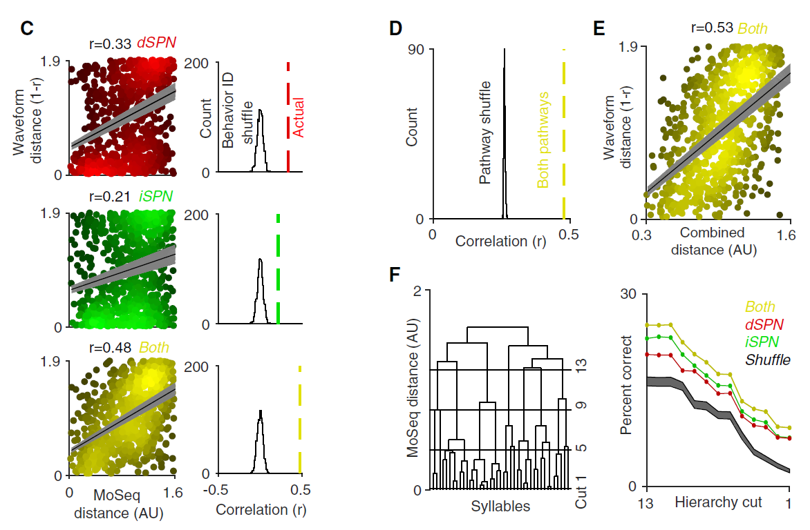
Successful decoding of syllable identity from neural activity

Slide 18
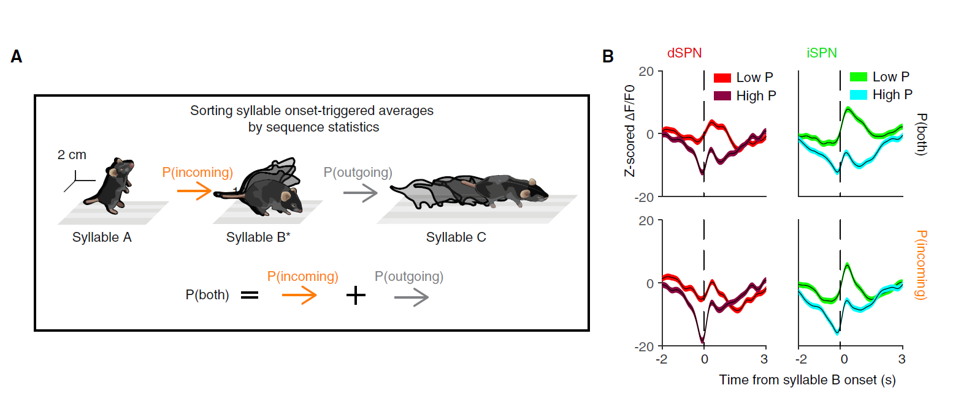
Question: does the activity of direct-indirect pathway depend upon the context in which the syllable is expressed?

Slide 19
High-probability transitions
Lower activity

Slide 20
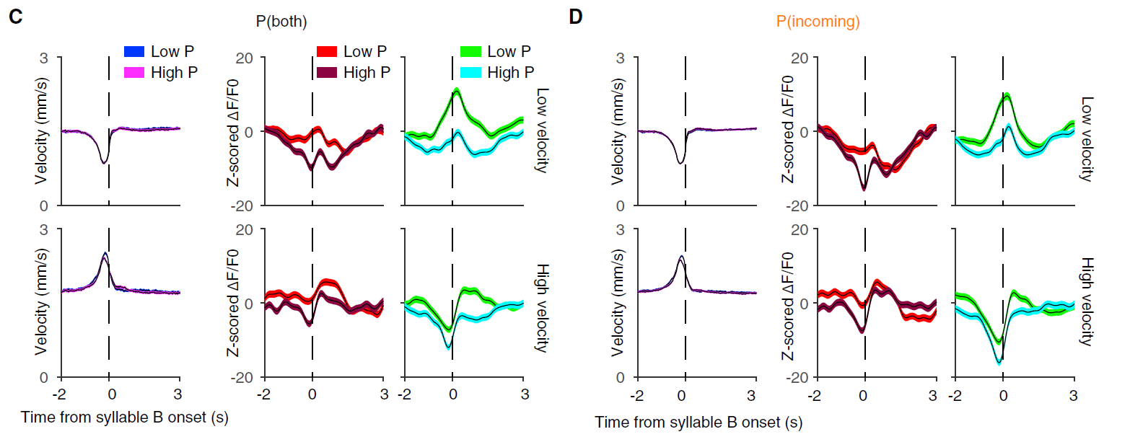

Slide 21
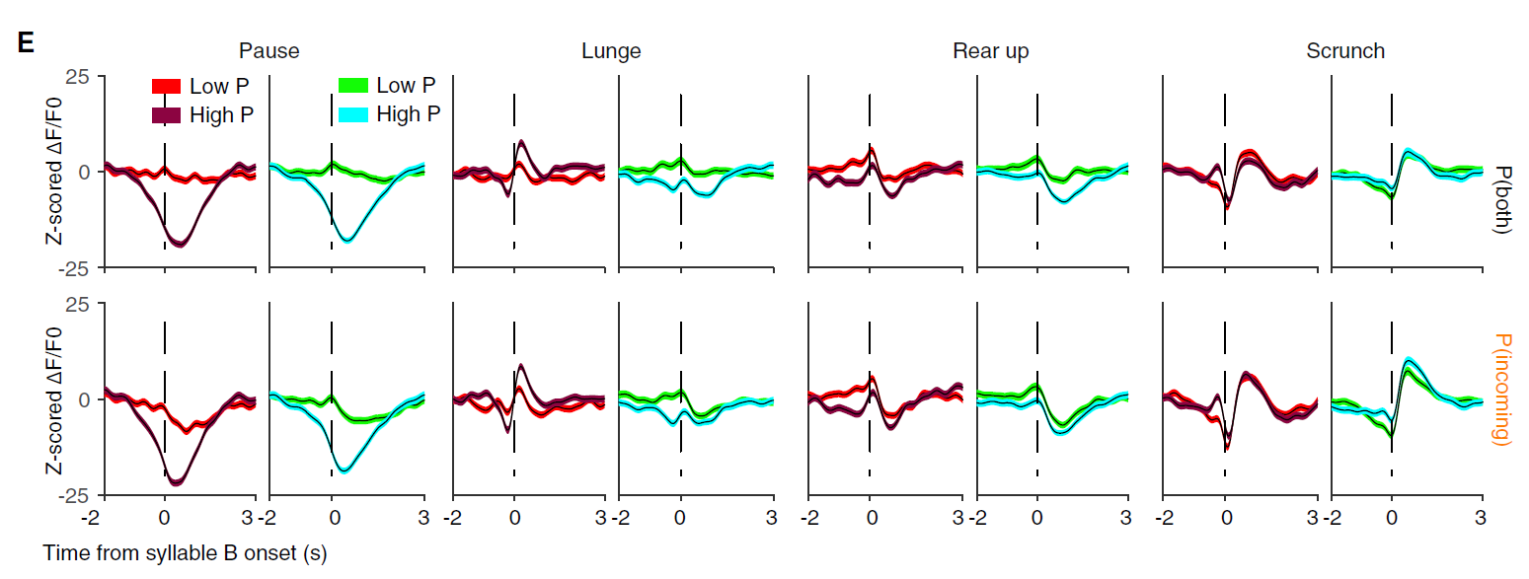
Effect of context for each type of syllable

Slide 22
Populations of neurons in both pathways are active around syllable transitions
An ensemble code of behavioral syllables

Slide 23
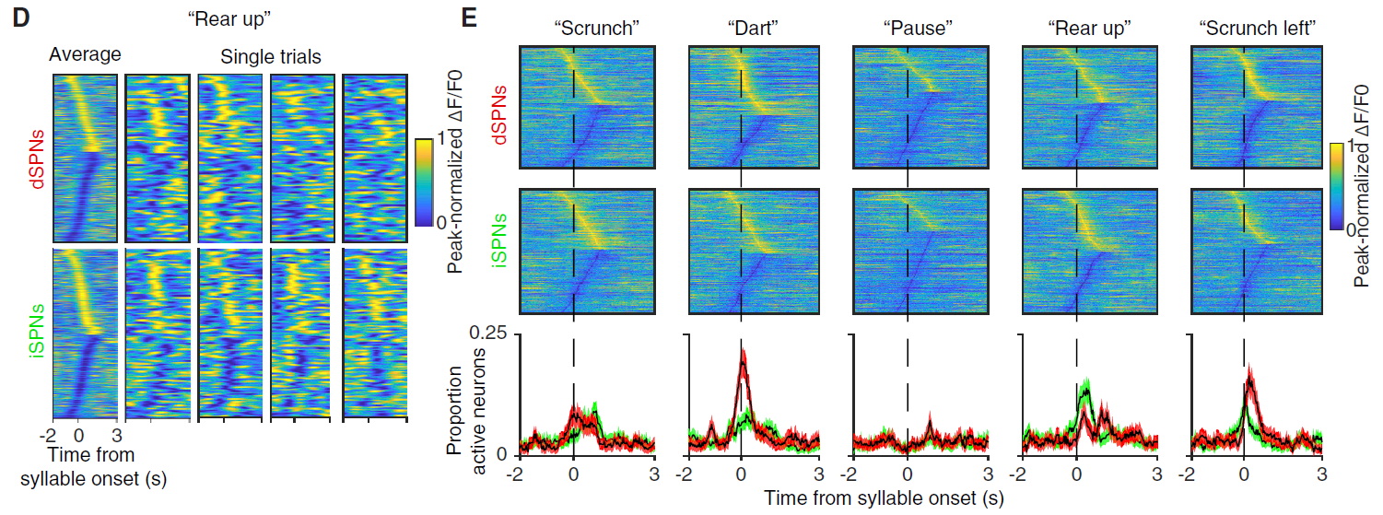
An ensemble code of behavioral syllables
Different groups of neurons are active at each instance of a syllable, but overall population statistics code for behavioral syllables

Slide 24
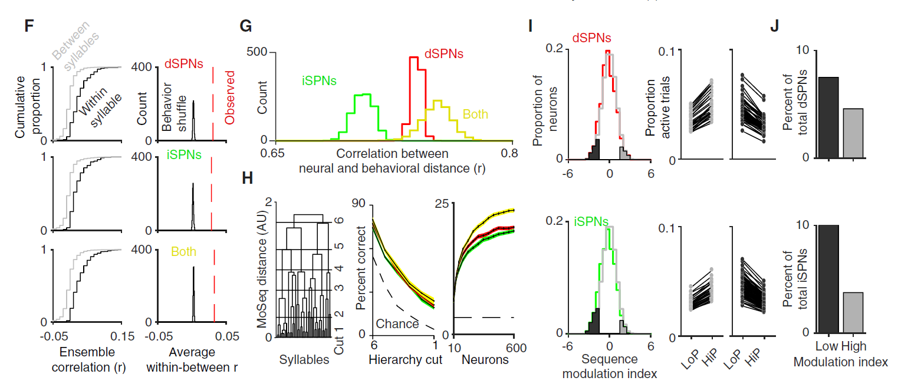
An ensemble code of behavioral syllables
Ensemble activity:
Are more similar within syllable than across syllables
Gives better than chance performance for decoding of behavioral syllables.

Slide 25
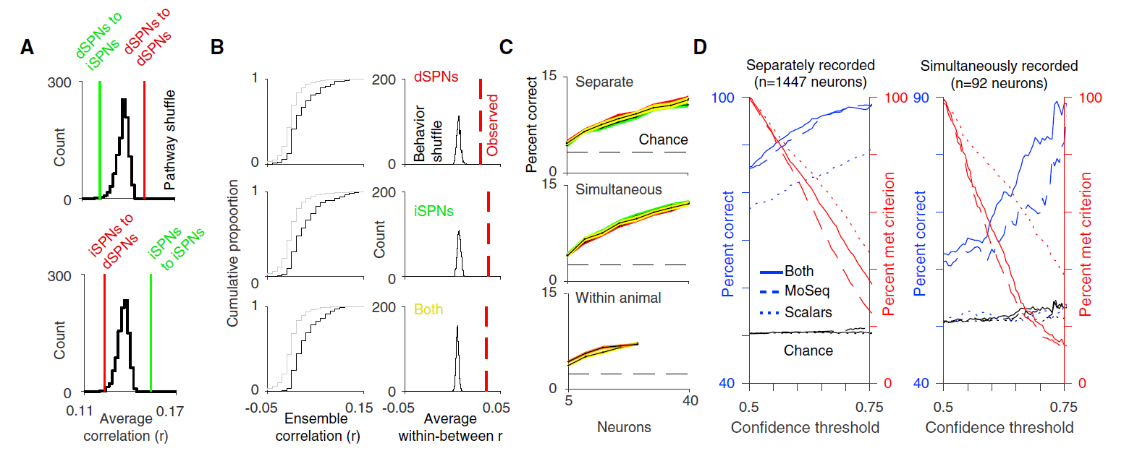

Slide 26
An ensemble code of behavioral syllables
Effect of sequence context:
Individual neurons can show increased or decreased activity in high-probability sequences.
However, overall inhibition for high-probability sequences.
Direct
Indirect

Slide 27
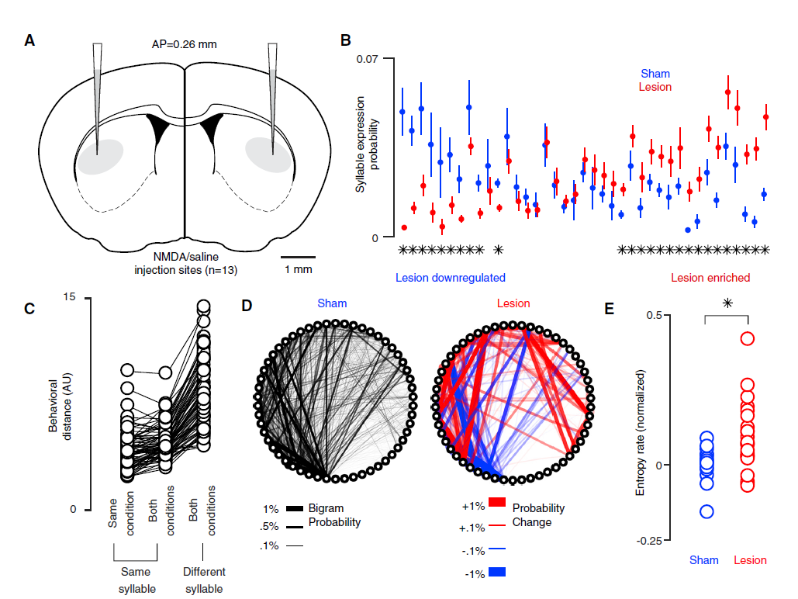
Lesion of the DLS
DLS lesion:
Does not alter content and number of behavioral syllables
Changes the frequency of syllables

Slide 28
Lesion of the DLS
DLS lesion:
Changes the transition probability between syllables
Results in more random sequences of syllables

Slide 29
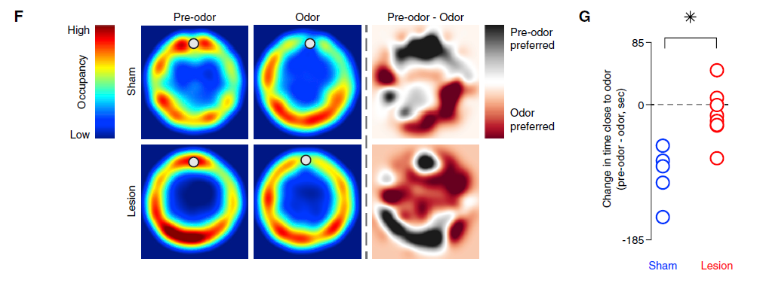
Lesion of the DLS
DLS lesion:
Reduces avoidance behavior after fox TMT exposure
Avoidance behavior was shown to involve changes in syllable transition frequency (Wiltschko et al., 2015)

Slide 30
Discussion
DLS encodes behavioral syllables and grammar
DLS systematically encodes syllable contents
Decorrelations at short time scales across syllables → complementary code for behavior
Future work:
Record from other sub-regions of dorsal striatum
Investigate longer-timescale structure of behavior
Investigate interaction between behavioral variability and reward to generate precise learned behavioral sequences.

